Slide 1
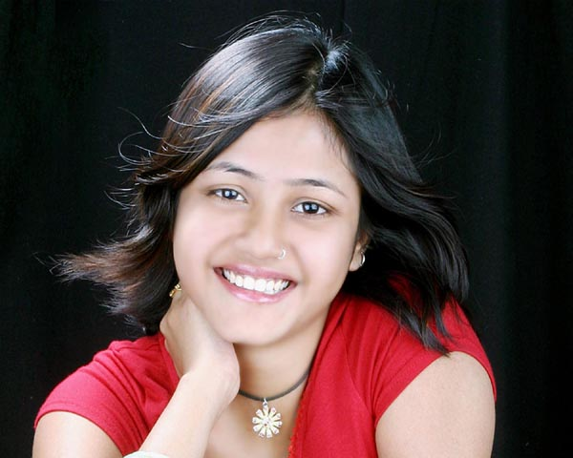
Hair
Eye Bro
Nose
Eye
Teeth
Ear
Lip
Palm
Neck

